Slide 1
Emotion-actionable analysis
By: Divyansh Rana

Slide 2
Normalization and preparing the data
Originally had 4 files with actionability annotations.
Combined the first 2 and last 2 as they were annotating the same tweets.
Added emotions and emotional score.
Concated all the dataframes and removed NaN values.

Slide 3
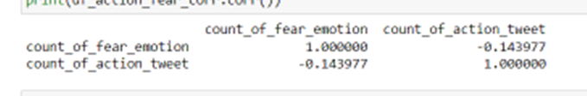
Research Question: How are emotions and actionability related?
Hypothesis: If a tweet displays fearful emotion then it’s less likely to be actionable. (from previous research)
The figure above shows co-relation between the number of fearful tweets and number of actionable tweets.
(Note: The data was extremely limited so the results could vary massively)

Slide 4

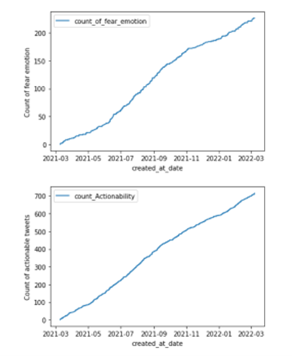
Emotions – actionability(by at least 1 marker)
Emotion and actionability over time.
The count specific count until that tweet and that’s why it just keeps increasing.
I believe these correlations are skewed because of improper time farmes.
fear coorelation: 0.9980225021191749
anger coorelation: 0.9948480518122937
joy coorelation: 0.9988794705373994
love coorelation: 0.9881082099925139
sadness coorelation: 0.992112189970303
surprise coorelation:0.9438949999368462

Slide 5
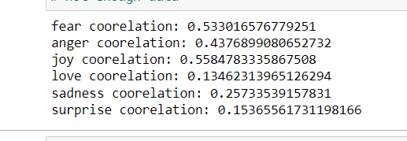
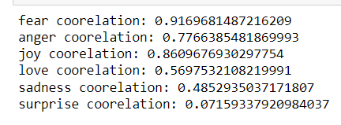
Emotion – actionability analysis with time
Figure 1
The first figure shows co-relation between emotions per day and actionable tweets. No major co-relations because the data is not big enough to be distributed into days.
Figure 2
And that’s why I distributed it into months in figure 2.
Strong correlation between fear, anger and joy emotion.

Slide 6
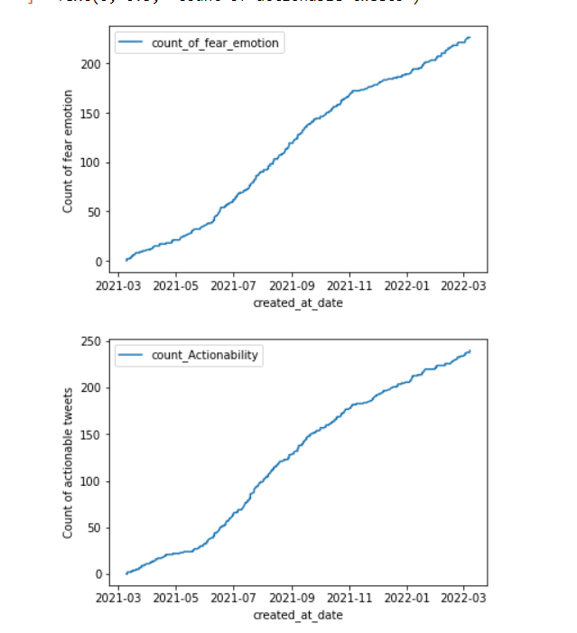
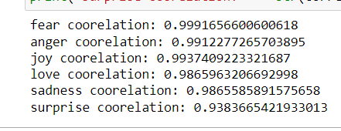
Emotions – actionability(by both markers)
Trying to double check the data using data from both the markers.

Slide 7
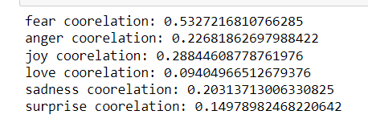
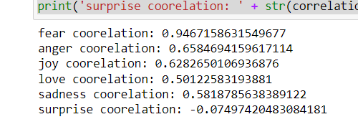
Emotion – actionability analysis with time
Figure 1
The first figure shows co-relation between emotions per day and actionable tweets. No major co-relations because the data is not big enough to be distributed into days.
Figure 2
And that’s why I distributed it into months in figure 2.
Very strong correlation between fearful emotions and tweets found actionable by both markers.

Slide 8
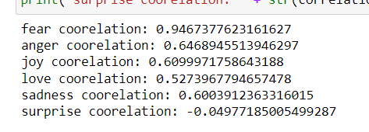
Emotion-actionability analysis (with emotions with very high emotional score)
Just backs my hypothesis as even with very high emotional score, fearful tweets are strongly linked with actionability.

Slide 9
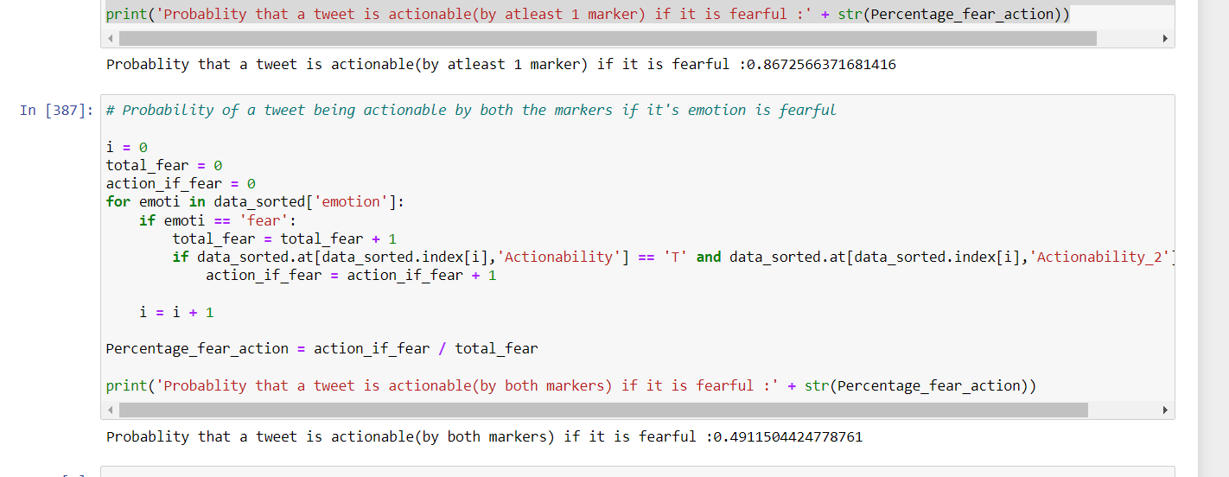
Result.
After going through the data, the hypothesis has been proven false as tweets conveying fearful emotions are most likely to be actionable.

